Slide 1
AI Meme & Poster Creator
CAPSTONE PROJECT
Presented By:
Jella Srikanth - Vignan Institute of Technology & Science - Electronics and Communication Engineering

Slide 2
OUTLINE
Problem Statement
System Development Approach
Algorithm & Deployment
Result
Conclusion
References

Slide 3
Problem Statement
Students often need posters and memes for events, college activities, or social media.
Designing this content traditionally requires creativity, graphic design skills, and specialized software.
Problem: There is a need for an AI-based tool that can simplify content creation by combining templates, AI-generated images, and captions, making the process more fun and accessible for everyone.

Slide 4
System Approach
Frontend: Backend: Model Engine: Image Processing: | A Streamlit application provides a simple and interactive user interface with text boxes for image descriptions, captions, and an area to display the final image. Python logic handles the user input, makes API calls to the image generation model, and processes the final image. A text-to-image model (Stable Diffusion) is accessed via the Hugging Face Inference API to generate the base image from a text prompt. The Pillow (PIL) library is used to overlay the user's caption text onto the AI-generated image.

Slide 5
Algorithm & Deployment
User Input: The user enters a descriptive prompt for the desired image (e.g., "An astronaut riding a horse") and the text for the meme caption.
API Call: The Python backend sends the image prompt to the Stable Diffusion API endpoint.
Image Generation: The AI model processes the prompt and returns a generated image as a binary object.
Text Overlay: The backend uses the Pillow library to draw the user's caption onto the received image, adding styling like a stroke for visibility.
Display Result: The final composite image (meme/poster) is displayed in the Streamlit interface, along with a button to download the file.

Slide 6
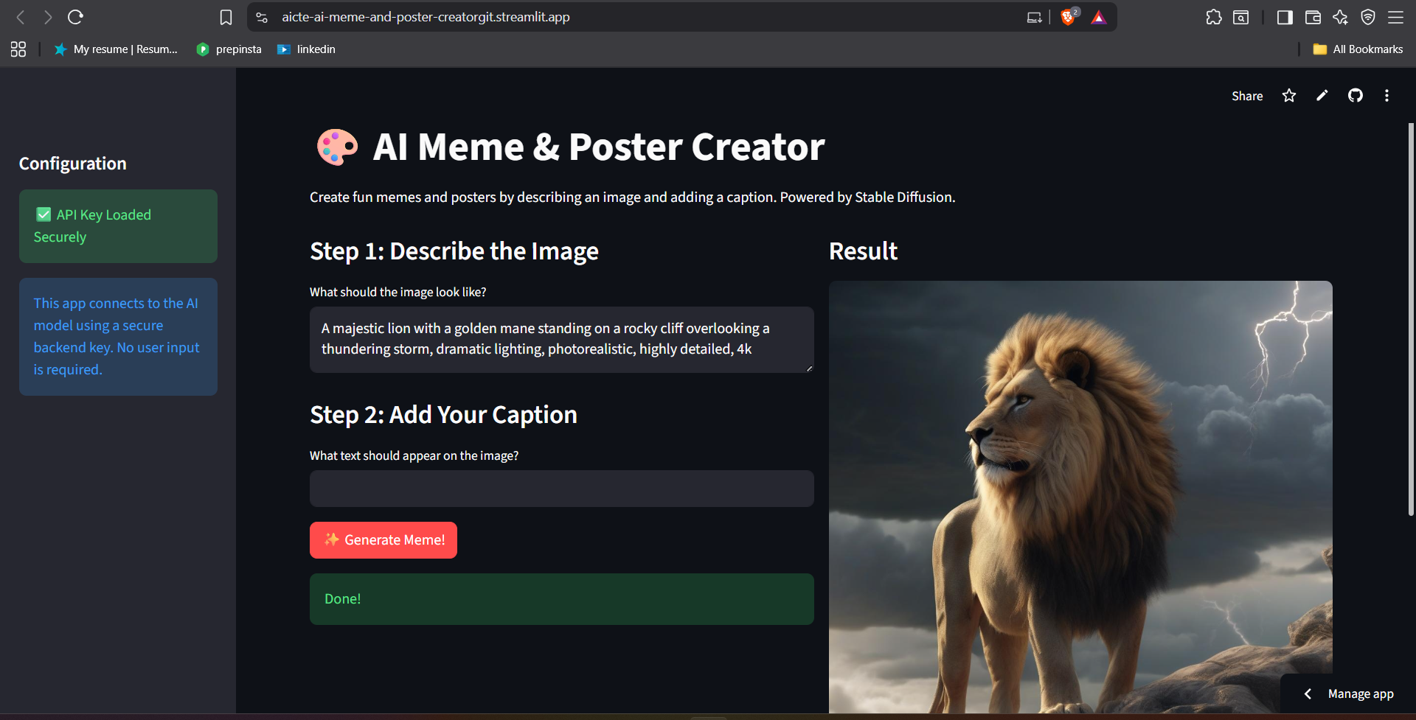
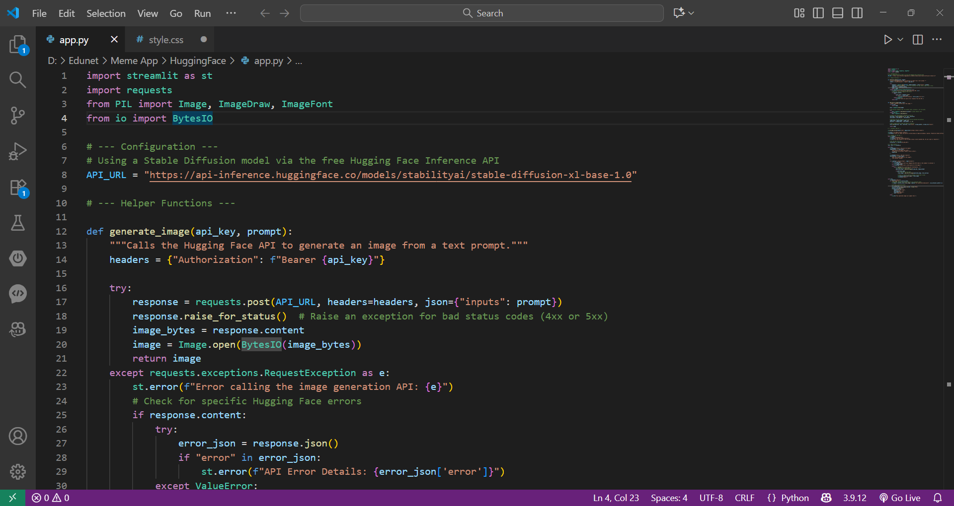
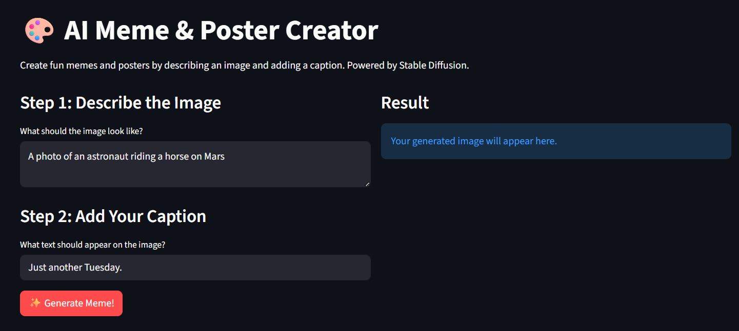
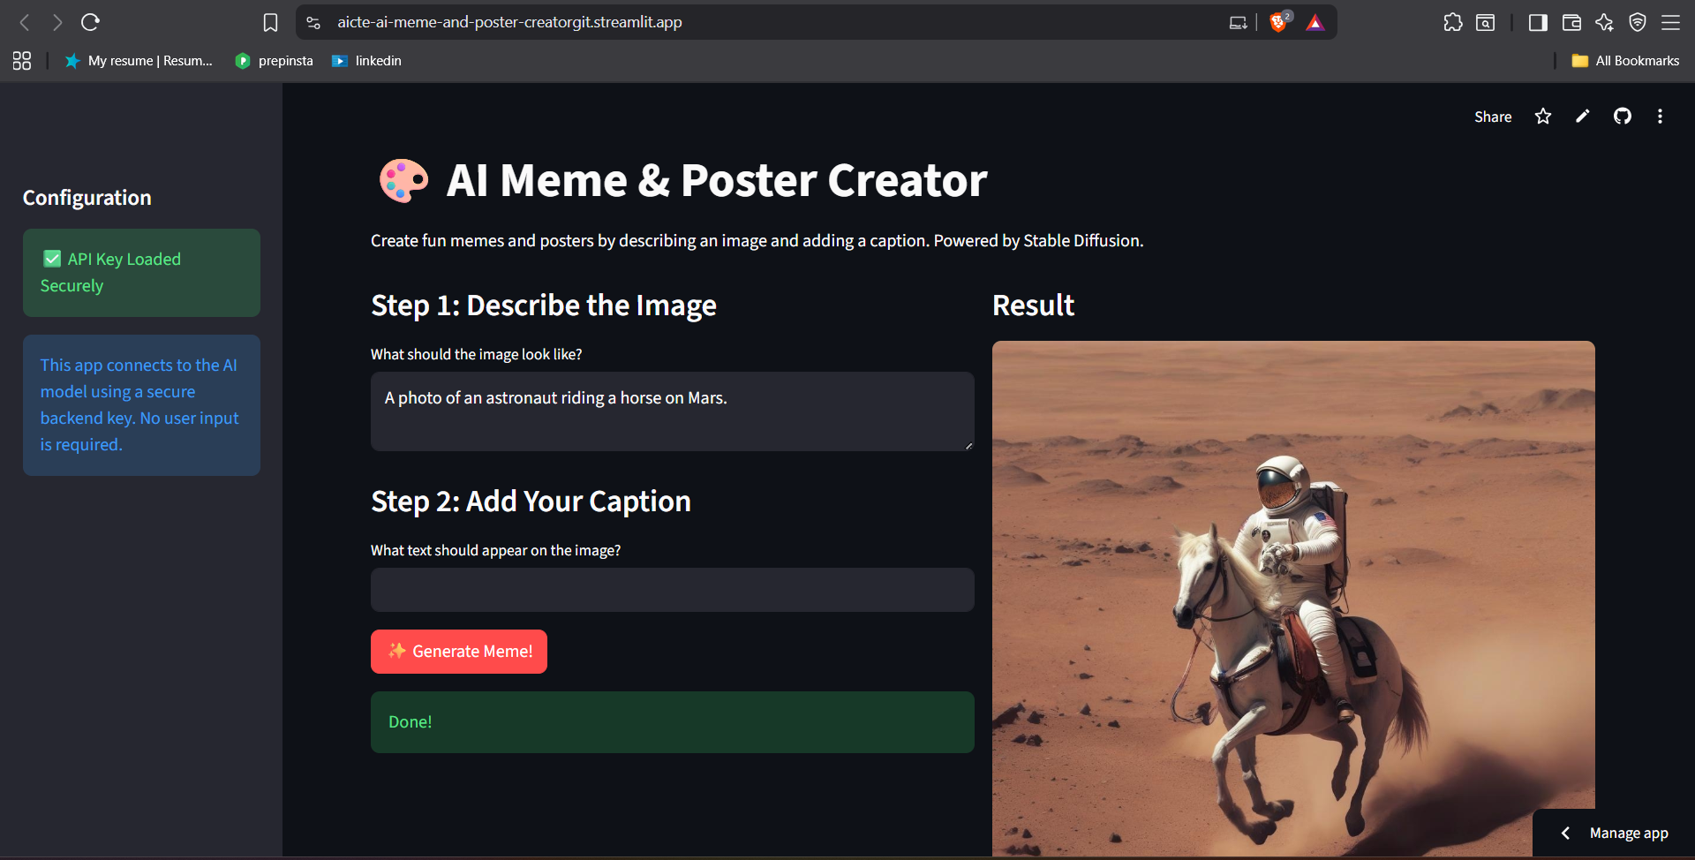
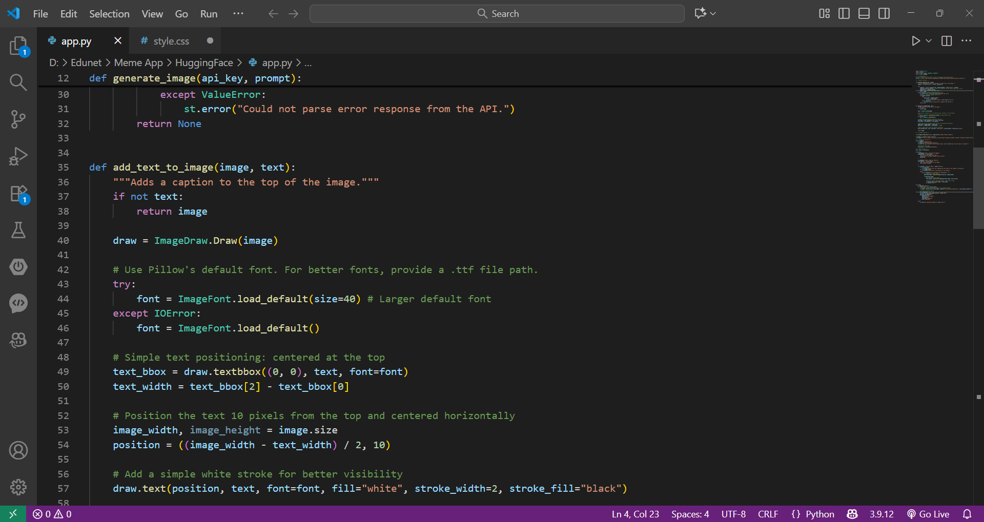
Result

Slide 7
GITHUB AND DEPLOYMNET LINK
Github Link : https://github.com/JellaSrikanth/aicte-ai-meme-and-poster-creator.git
Deployment link: https://aicte-ai-meme-and-poster-creatorgit.streamlit.app/

Slide 8
Conclusion
This project successfully addresses the challenge of creating visual content by providing a simple, AI-powered tool for students and users without design experience.
The application demonstrates a practical and modern use of generative AI, combining a powerful text-to-image model with a user-friendly web interface built in Python.
The final product is an engaging and effective tool that simplifies the creation of memes and posters, making content creation faster and more accessible.

Slide 9
References
Streamlit Documentation
Pillow (PIL Fork) Library Documentation
Hugging Face Inference API Documentation
Python requests Library Documentation

Slide 10
THANK YOU

